Slide 1


Slide 2




ABOUT TEAM
MENTOR:
Mr. Bhanu Kapoor
SUMBMITTED BY:
Khushal Agarwal ( 201500340 )
Kalyani Agarwal ( 201500324 )
Tanmay Goyal ( 201500738 )
Yuvraj Soni ( 201500837 )

Slide 3

ABOUT PROJECT
‘Tripify’ will play an essential role in making decisions like choosing a hotel. This system heavily relies on individuals voluntarily submitted reviews to build the reputation for nearby businesses. Unfortunately, the reviews expose user(s) private information such as visited places to the public and adversaries. Even worse, such location information is usually public because it is that the basic information of companies , and adversaries might be anyone starting from advertisement spammer to physical stalker. This website formalizes the privacy preserving problemin hotel review systems. The framework can preserve users’ location privacy in arbitrary local area and may maintain an honest utility for both the system and each user. We evaluate our framework towards real-world data traces. The results validate that the framework are able to do an honest performance.

Slide 4

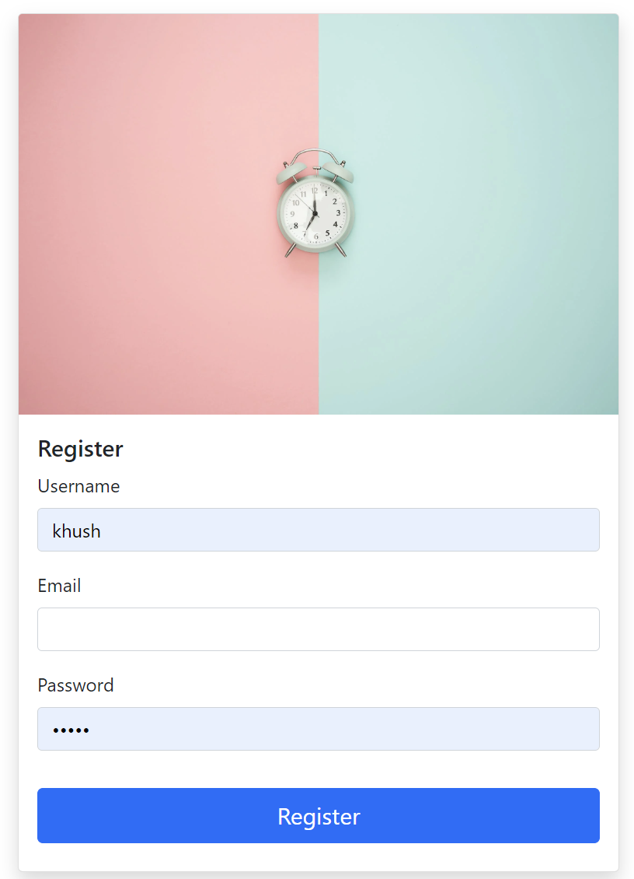
Register Page
This registration page has fields like username,email, password and register button.
Once the Register button is clicked, the user credentials will get stored & redirected to home page.
If the user has already an account then can simply sign in.

Slide 5
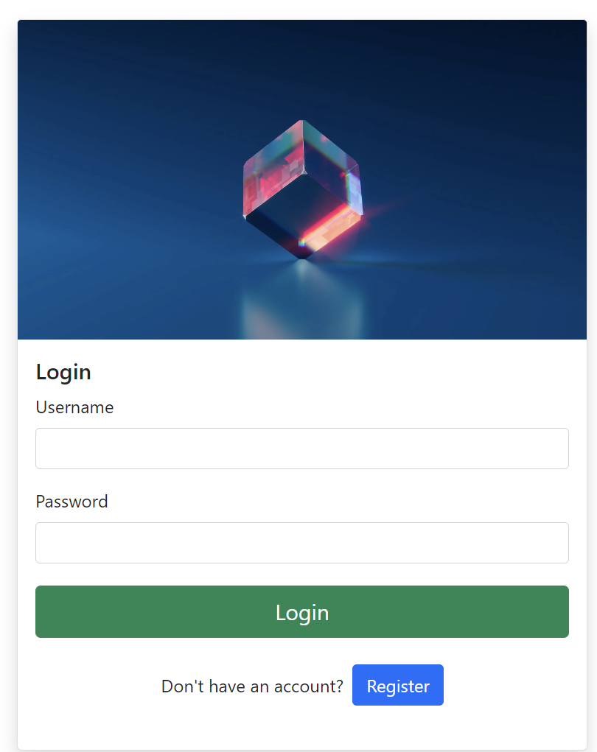
Login Page
In this page, the user can login to the website using their respective username and password.
On clicking the login, the application will authenticate the user with the credentials stored.

Slide 6
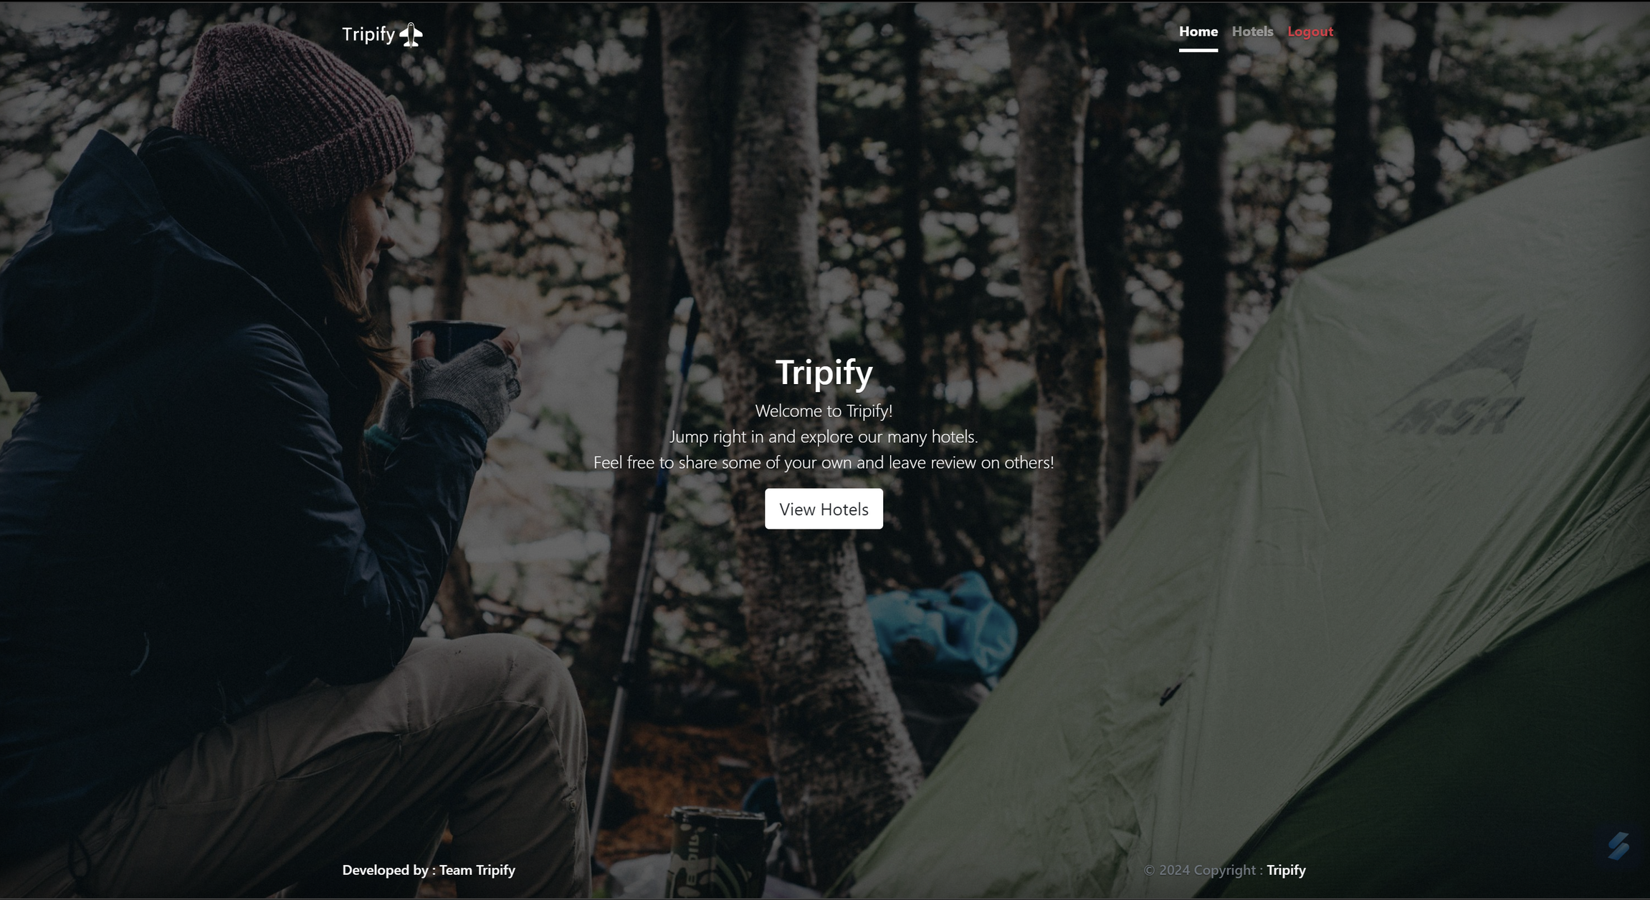


Landing Page

Slide 7

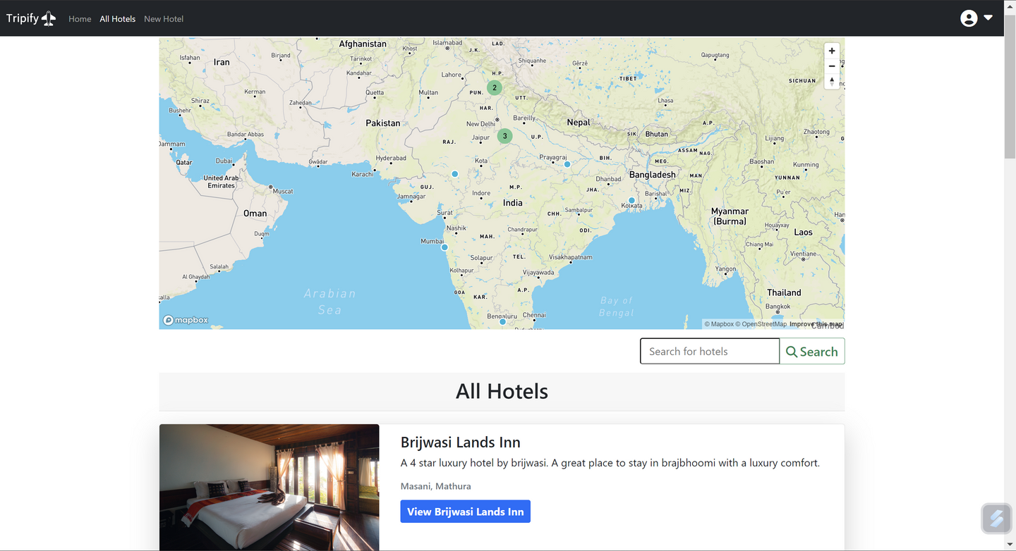

HOME PAGE
Home page is the first page that serves some valuable & informative content to customers. This is the place to capture their attention.
It contains the list of hotels along with a cluster map of all available hotels with an embedded Fuzzy search.

Slide 8

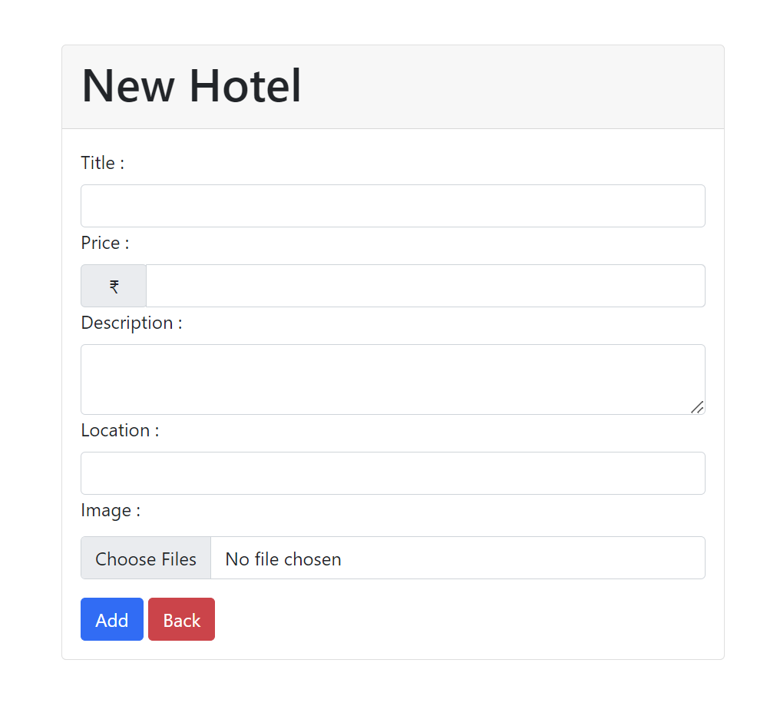
NEW HOTEL FORM
On this page, you can add a new hotel on the website.
Only after successful login user can visit this page.
User can upload photos also in this form.

Slide 9
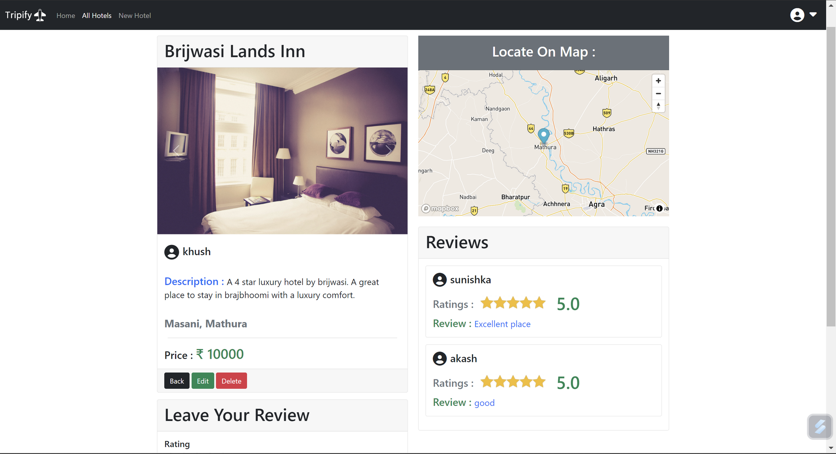
Hotel Show Page
This Page will show all the required details regarding a particular hotel.
This page also shows the reviews regarding a hotel.
User can also post a review on this page. And for each review user gets points which they can redeem in Shop.

Slide 10
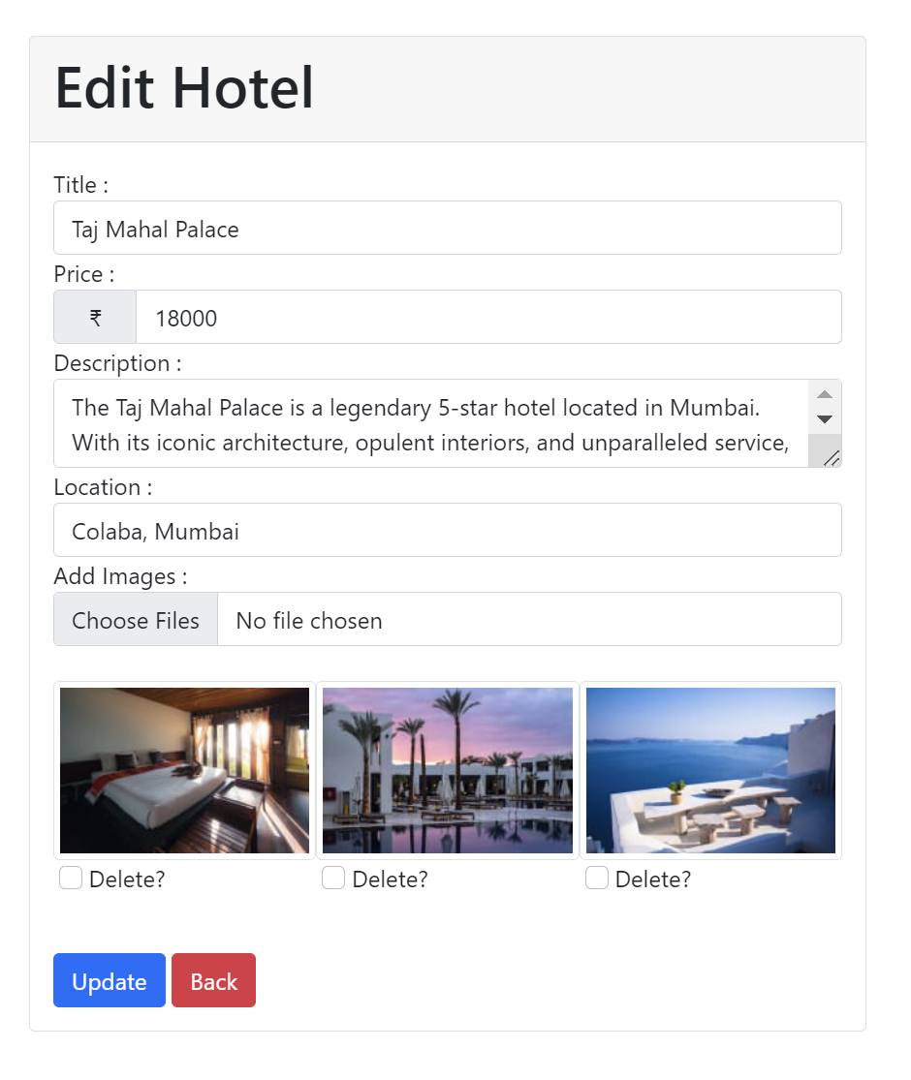
EDIT HOTEL FORM
On this page, you can edit a existing hotel on the website.
Only the owner of hotel can edit hotel on this page.
User can upload new photos as well as delete previous ones also in this form.

Slide 11
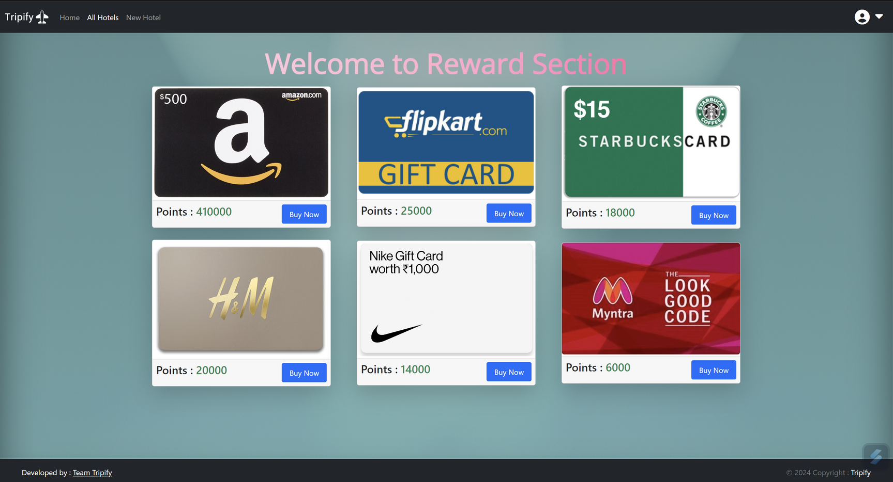

REWARD
Users can redeem their rewards on this page.
Rewards can be claimed using the points that users can earn by submitting reviews for different hotels.

Slide 12

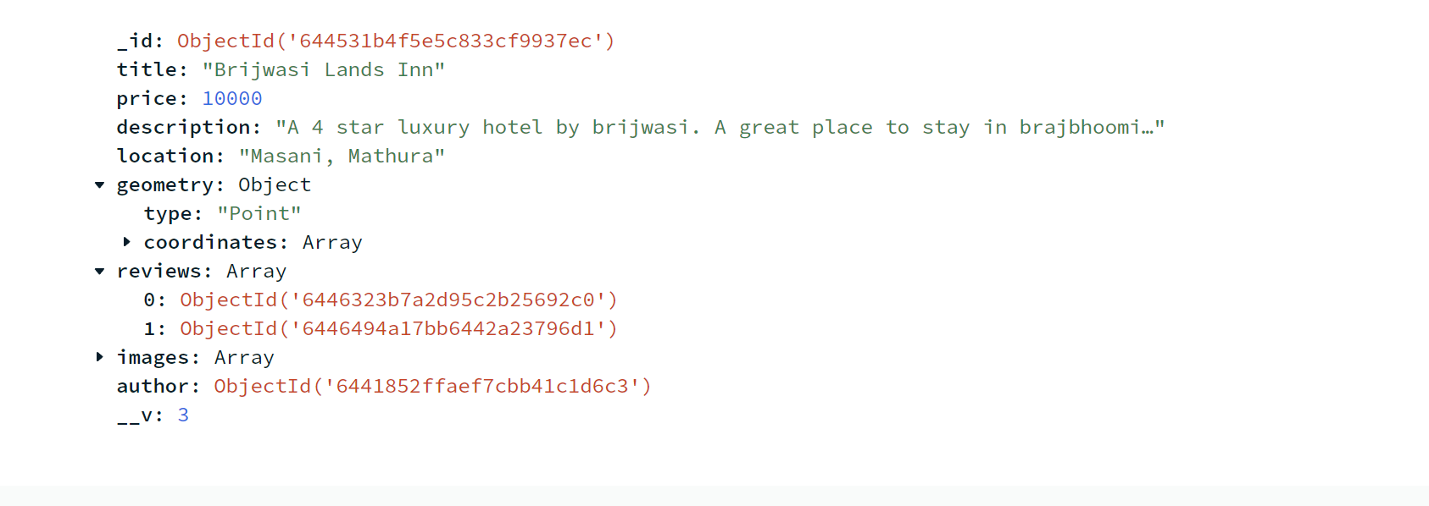

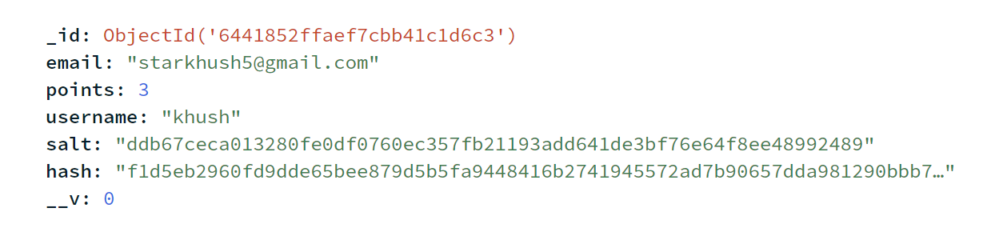
DATABASE
MongoDB Compass is used for managing database.
It also stores the information of hotels, their reviews, users and stores sessions.
It will store the data of the user and will use it for authentication.

